Slide 1
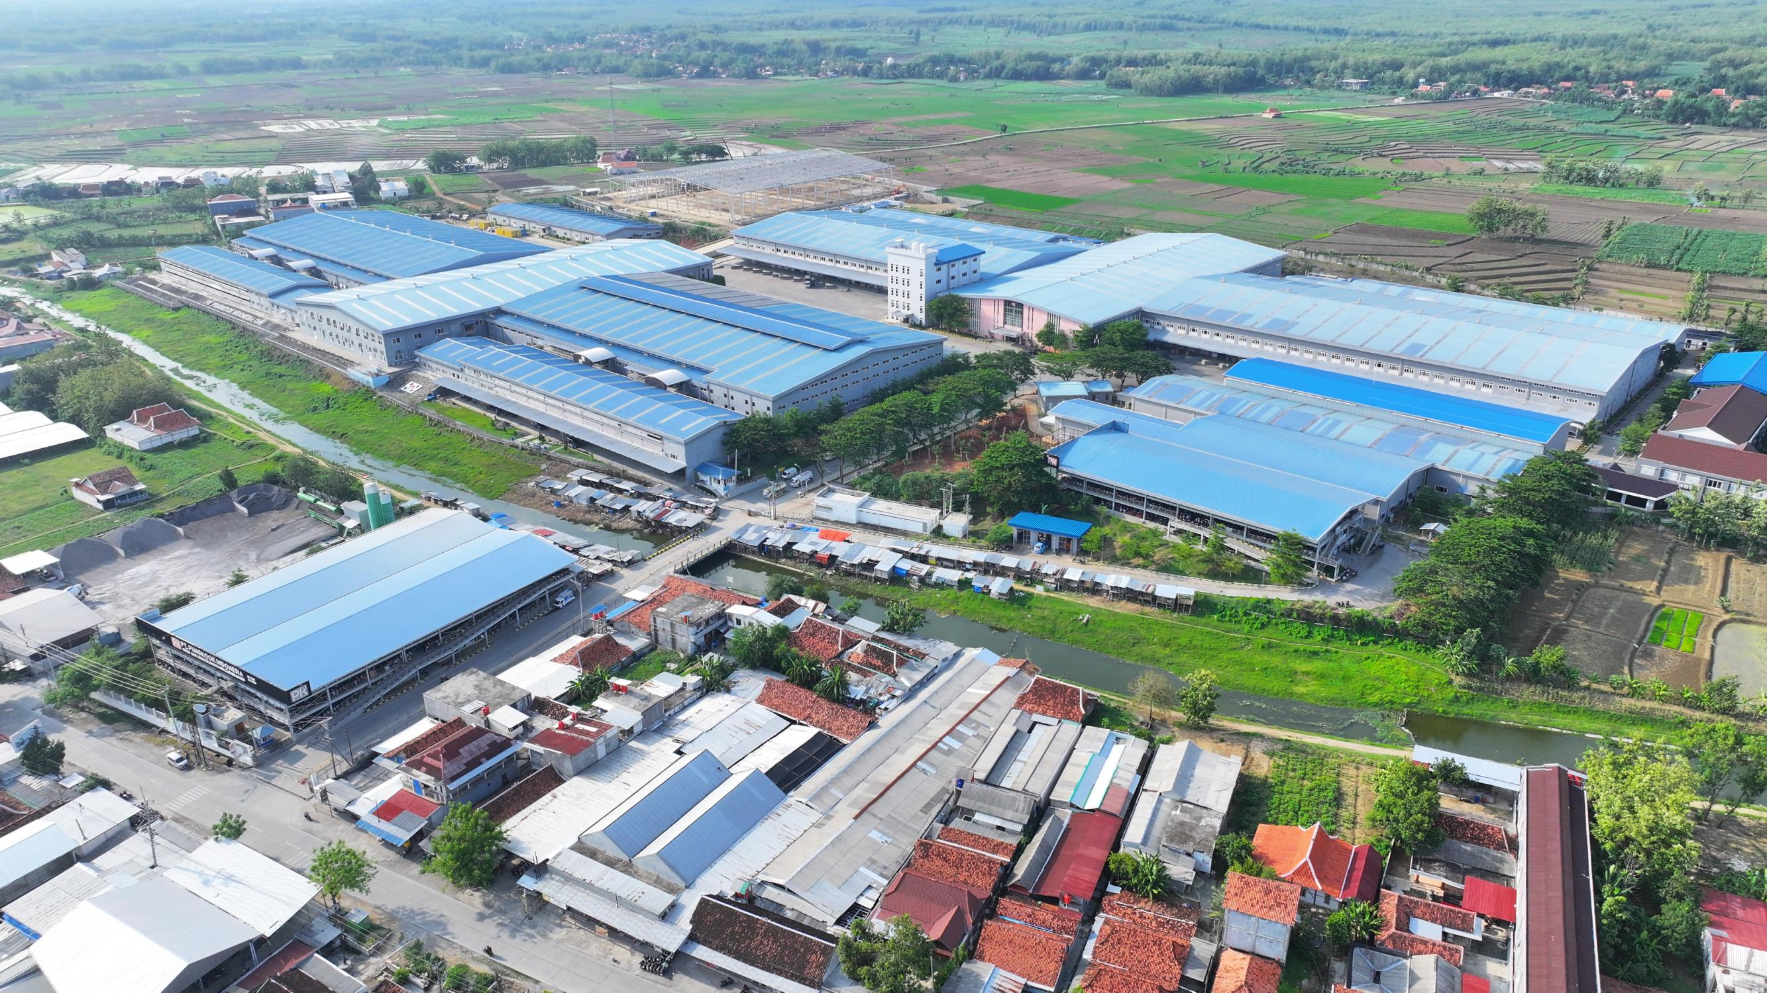
DECARBONIZATION
PT PUNGKOOK INDONESIA ONE

Slide 2

GREENHOUSE GAS EMISSIONS
Reducing the risk of environmental pollution is one of the commitments stated in our company's Environmental Policy. Pungkook Corporation, which oversees two companies in Indonesia, PT Pungkook Indonesia One in Subang, West Java and PT Pungkook Indonesia One in Grobogan, Central Java, has a strong commitment to decarbonization and reducing greenhouse gas emissions and work to supporting the use of renewable energy in its operations.
To ensure that we track all the emissions we produce, we collect data on all the energy we use and any carbon emissions we produce during our company operations using a scope 1, scope 2 and scope 3 assessment approach through the Kadin Net Zero Hub program.

Slide 3


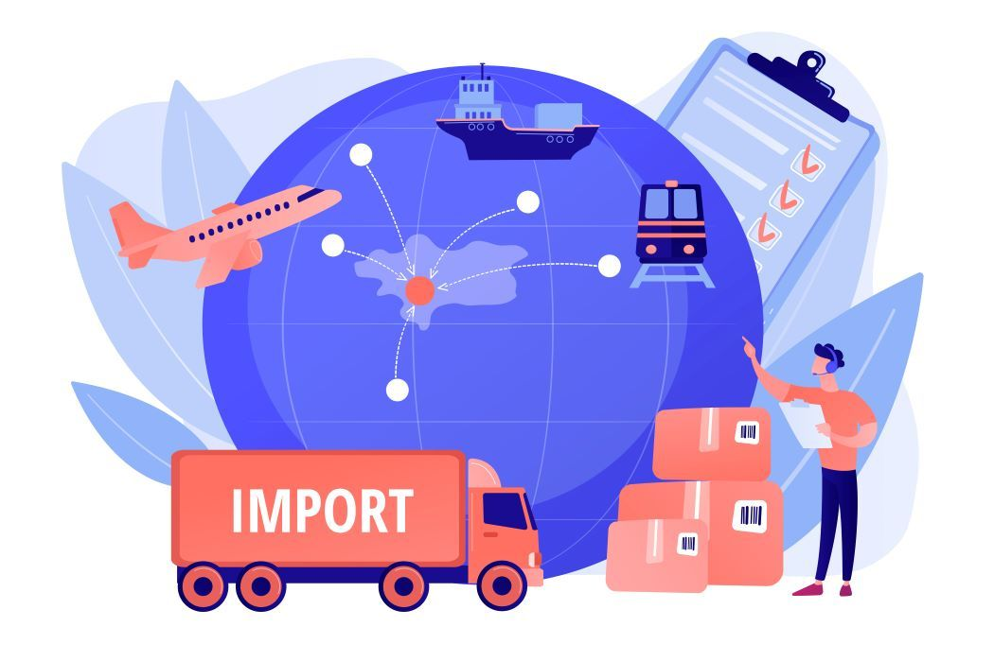
GREENHOUSE GAS EMISSIONS
Scope 1
Scope 1 covers emissions from sources owned or controlled directly by the company – for example from the combustion of fuel in our vehicle fleet (if the vehicles are not electric), air conditioning, generators, etc.
Scope 2
Scope 2 are emissions that a company causes indirectly and come from where the energy it purchases and uses is produced. For example, the emissions caused when generating the electricity that we use.
Scope 3
Scope 3 encompasses emissions that are not produced by the company itself and are not the result of activities from assets owned or controlled by them, but by those that it’s indirectly responsible for up and down its value chain. An example of this is when we buy, use and dispose of products from suppliers. Scope 3 emissions include all sources not within the scope 1 and 2 boundaries

Slide 4
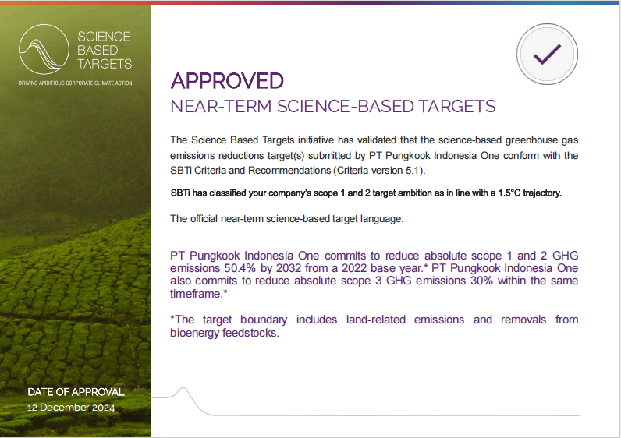
GREENHOUSE GAS VALIDATION

Slide 5
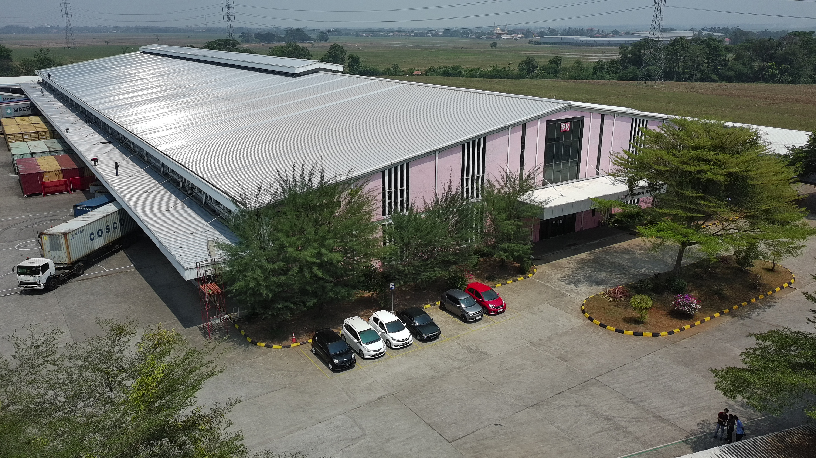
GREENHOUSE GAS INVENTORY
PT Pungkook Indonesia One successfully reduced scope 1 & 2 emissions by -2.65%, and scope 3 emissions by -1.66% in 2024 compared to baseline emissions in 2022.
We have made efforts to reduce GHG through several programs such as purchasing RECs (Renewable Energy Certificates) and energy efficiency programs.

Slide 6




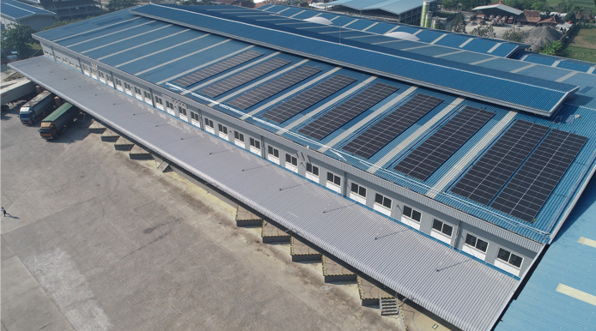

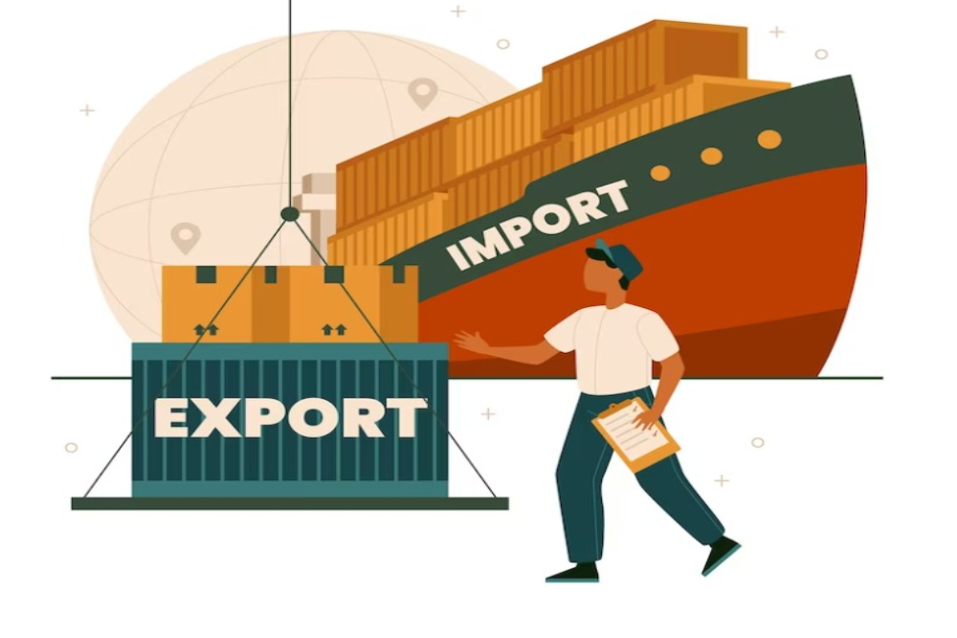

2032 REDUCTION EMISSION TARGET
Scope 1 & 2
Scope 3
Reducing GHG emissions in scopes 1 and 2 by 50.4% in 2032 from the baseline year of 2022 by using renewable energy and collaborating with related parties in purchasing renewable energy certificates.
Reduce Scope 3 GHG emissions by 30% by 2032 from a 2022 baseline by collaborating with our supply chain (suppliers, customers and logistics providers) to establish environmentally friendly procurement, particularly related to sustainable transportation and distribution policies. We will prioritize and increase the delivery of our products using low-emission transportation modes. We will also explore opportunities to reduce emissions from employee travel by providing amenities that encourage employees to travel in more environmentally friendly ways (e.g., providing bicycle storage, lanes, carpools, etc.)

